Slide 1



Introducing
WELL for residential

Slide 2
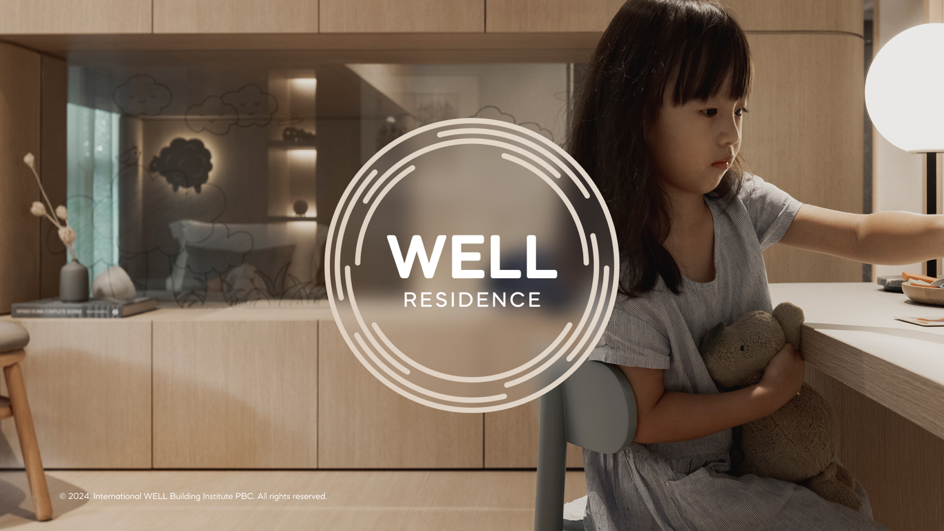

Slide 3
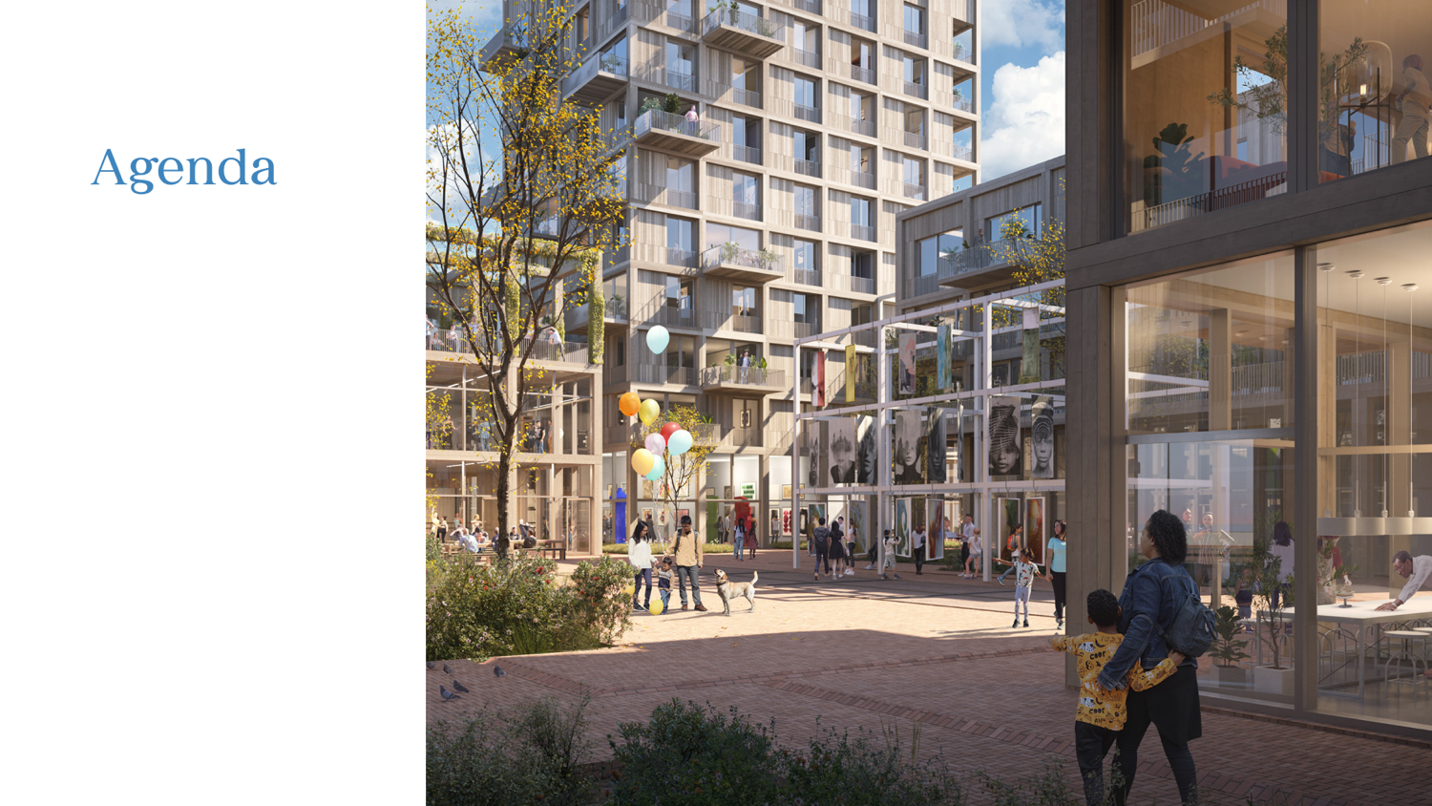
01 Placeholder
02 Placeholder
03 Placeholder
04 Placeholder

Slide 4
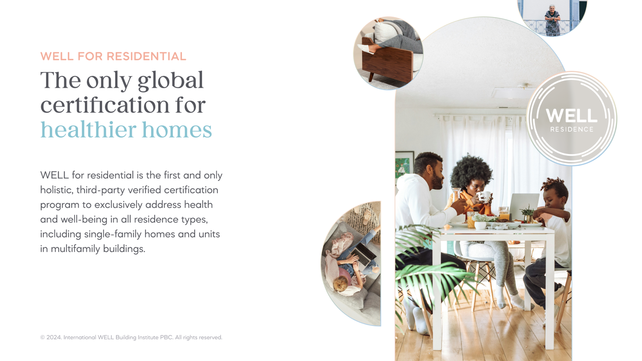

Slide 5
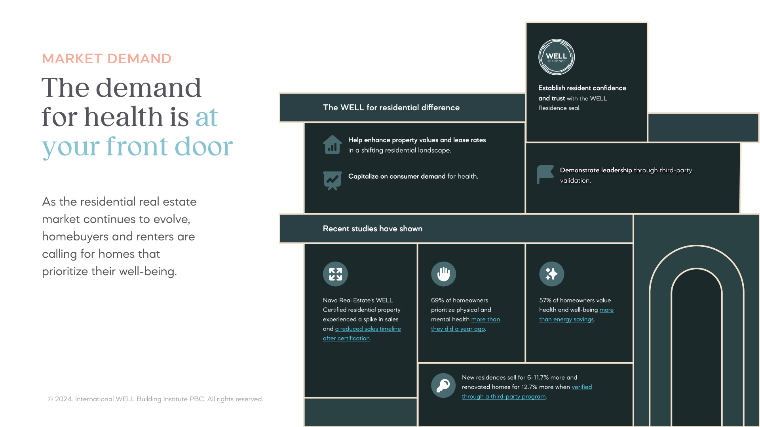

Slide 6
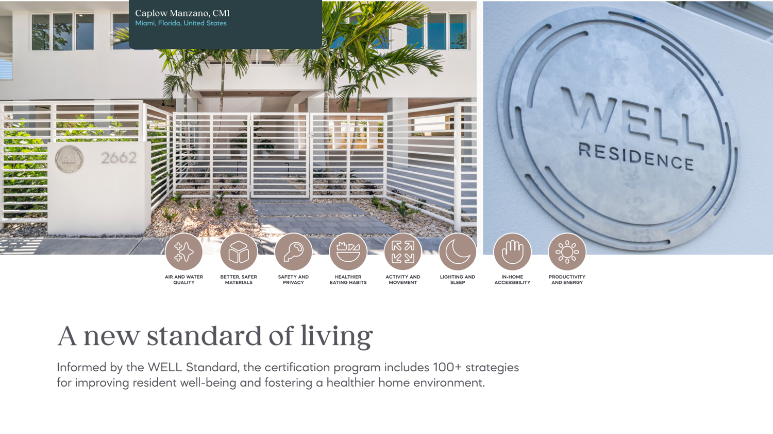

Slide 7
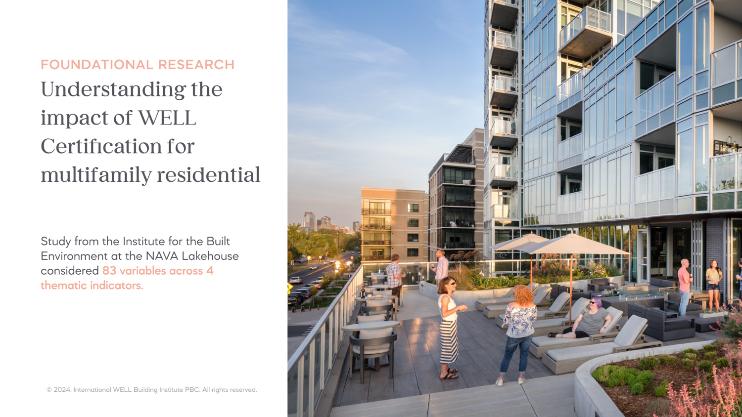

Slide 8
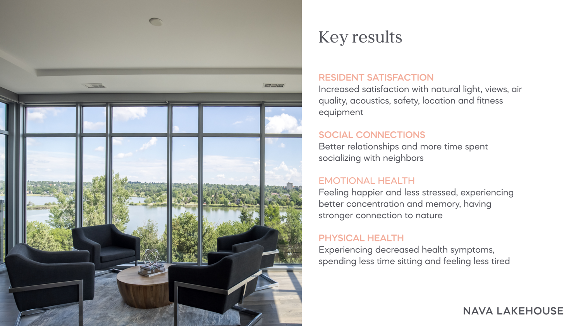

Slide 9
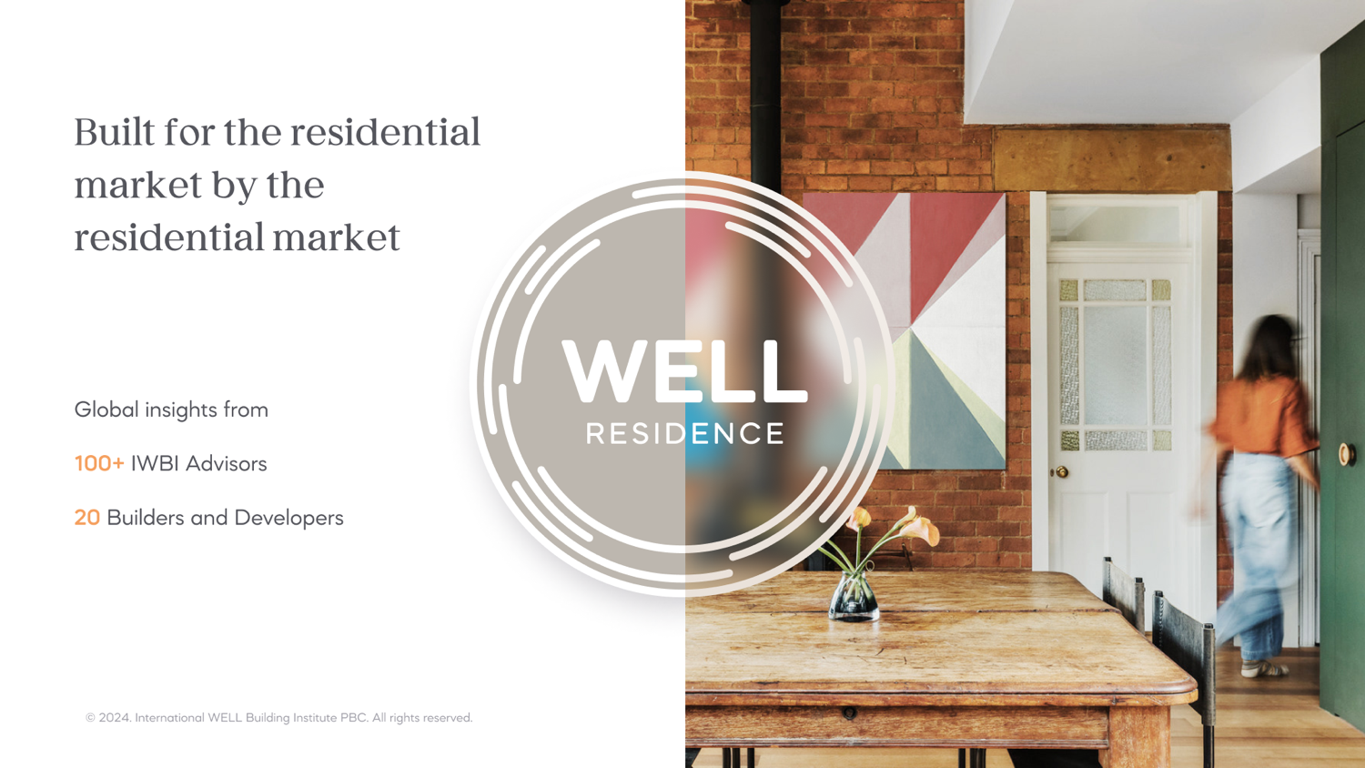

Slide 10
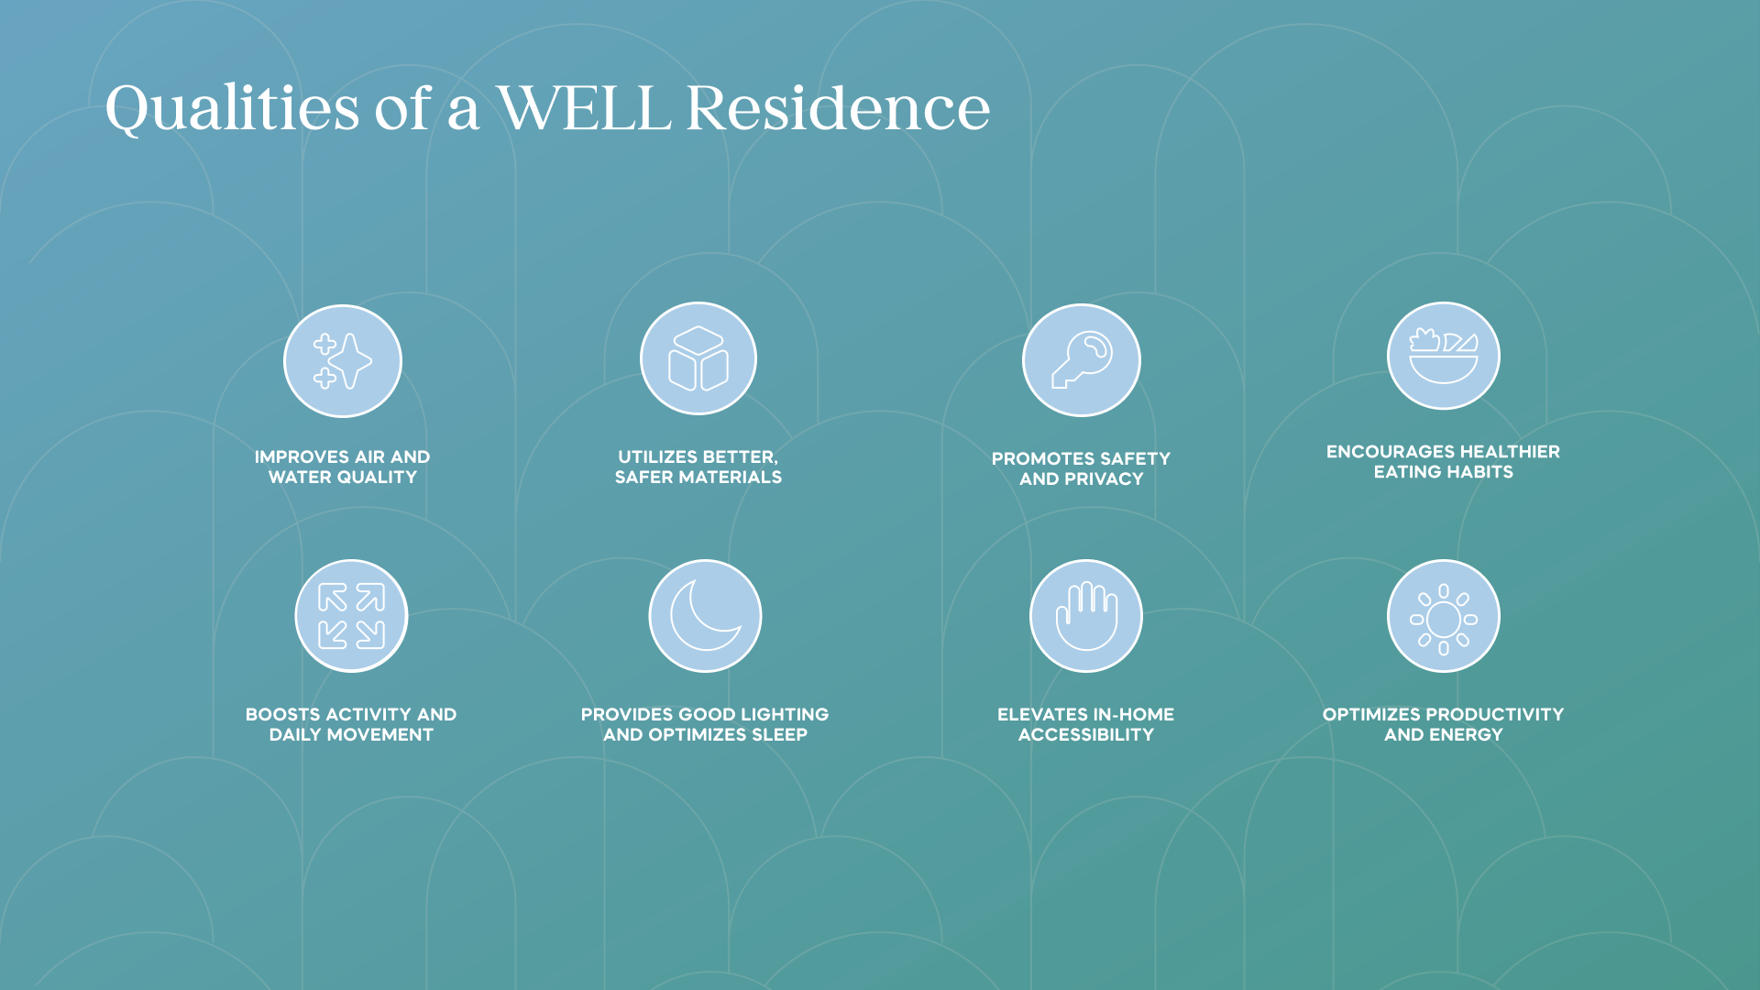

Slide 11
Strategies within the 10 WELL Concepts
Air
Ventilation Design
HVAC Filtration and Treatment
Pollution Infiltration Management
Construction Pollution Management
Combustion Minimization
Air Quality Monitoring
Indoor Air Quality Testing
Radon Risk Mitigation
Electric Vehicle Charging
Smoke-Free Environment
Water
Plumbing Design and Sizing
Water Testing
Non-Potable Water Capture and Use
Moisture Management Design
Flow and Temperature Sensing
Water Quality and Plumbing Maintenance
Nourishment
Supportive Cooking Environment
Onsite Food Production
Food Access and Support
Food Hygiene Support
Light
Design for Daylight
Electric Light Control and Quality
Visibility at Night
Movement
Pedestrian, Transit and Bike-Friendly Places
Outdoor and Indoor Activity Space
Adjustable Workstations
Staircase Design
Thermal Comfort
Thermal Performance and Control
Insulation and Fenestration Efficiency
Humidity Control
Radiant Heating Systems
Operable Windows
Outdoor Heat Management
Sound
Sound Barriers
Quiet Products
HVAC and Building Service Noise Levels
Environmental Noise Levels
Materials
Site Assessment and Remediation
New Materials Selection
Pest and Pesticide Minimization
Cleaning Products and Practices
Mind
Nature and Place
Design for Reassurance
Digital Connection
Household Storage and Space Management
Community
Universal Design
Housing Equity
Integrative Design
Healthy and Inclusive Construction Sites
Resident Education
Disaster Resilience
Fire Mitigation
Innovation
WELL AP
Residential Green Programs
Carbon Accounting, Disclosure & Reduction
Notes:
Bold denotes novel features

Slide 12
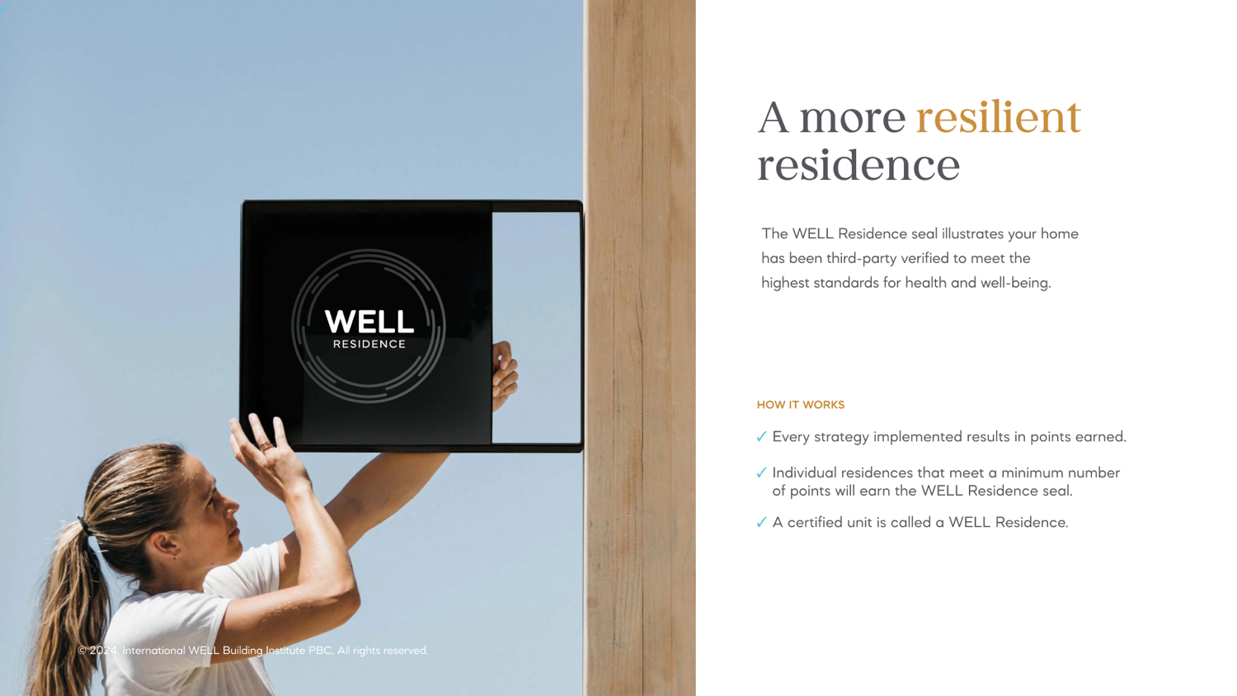

Slide 13
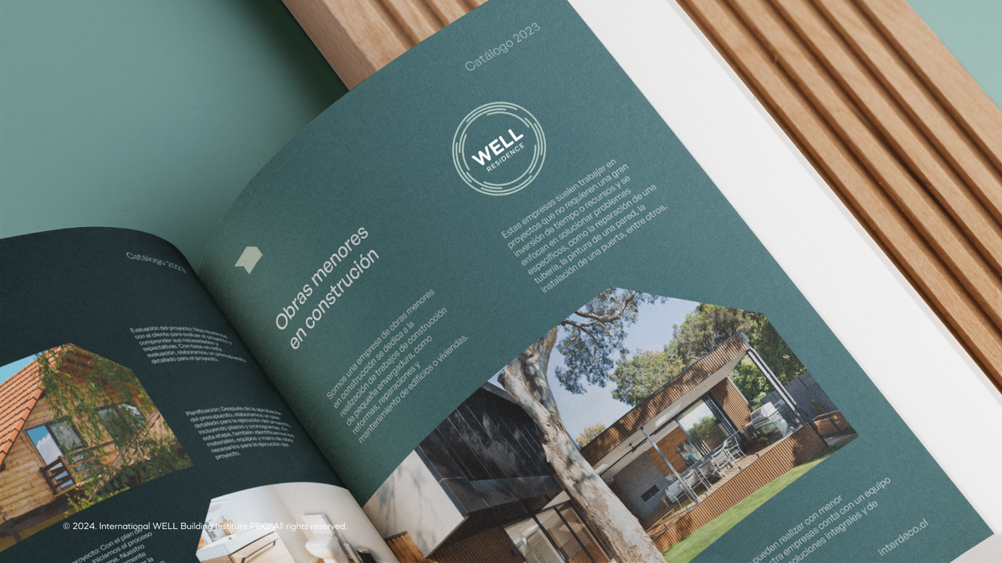

Slide 14
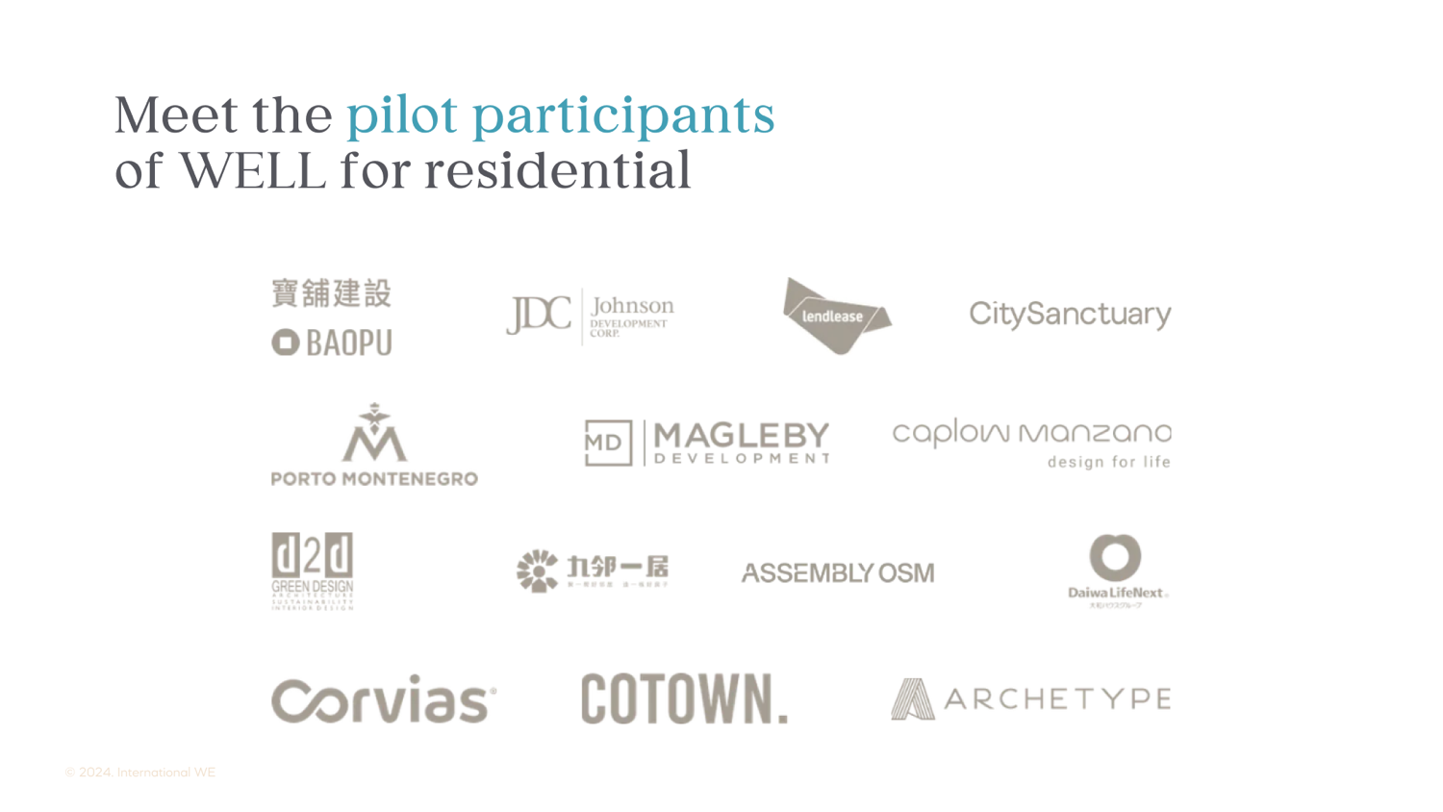

Slide 15
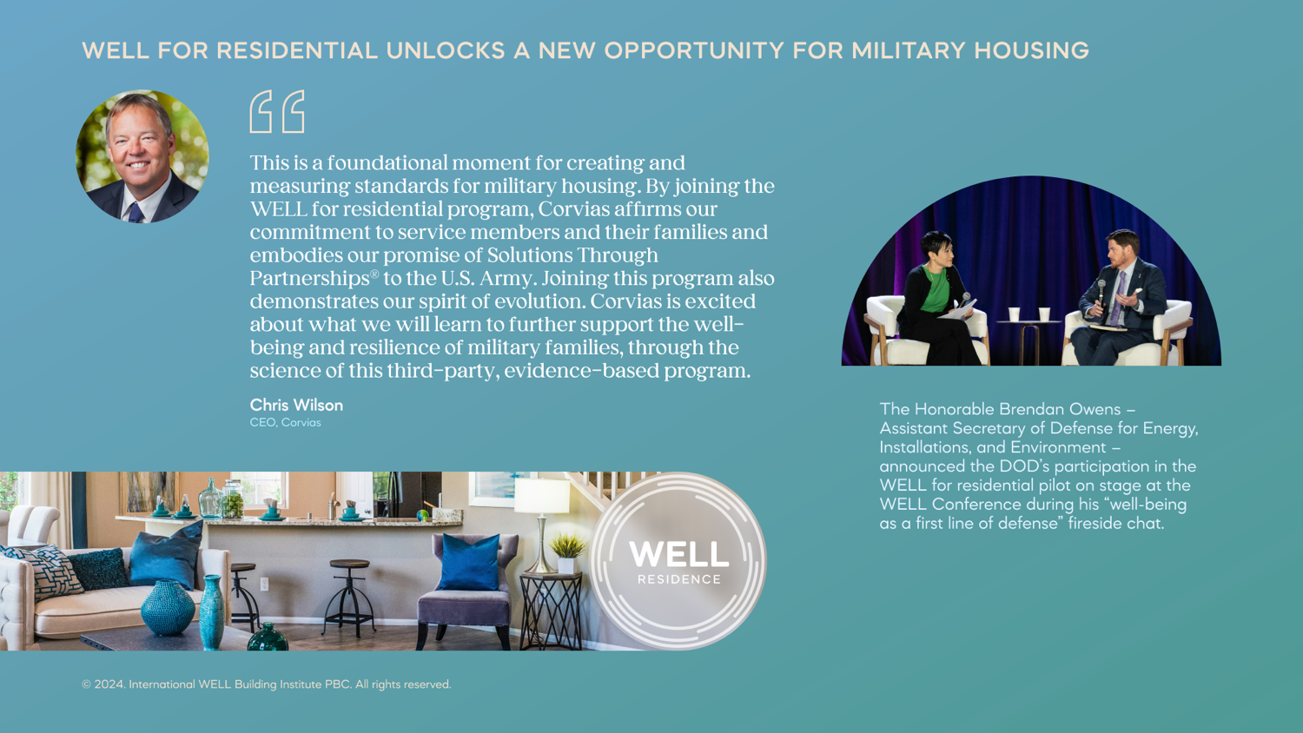

Slide 16
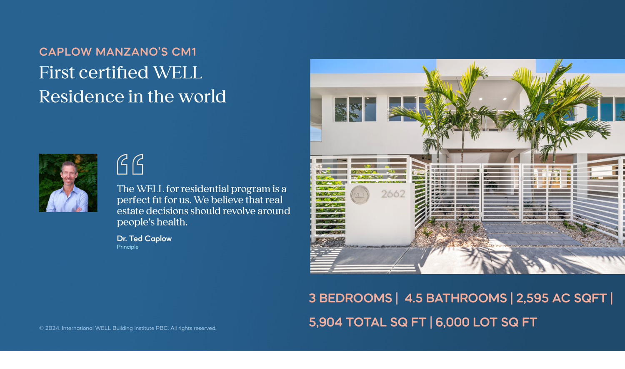

Slide 17
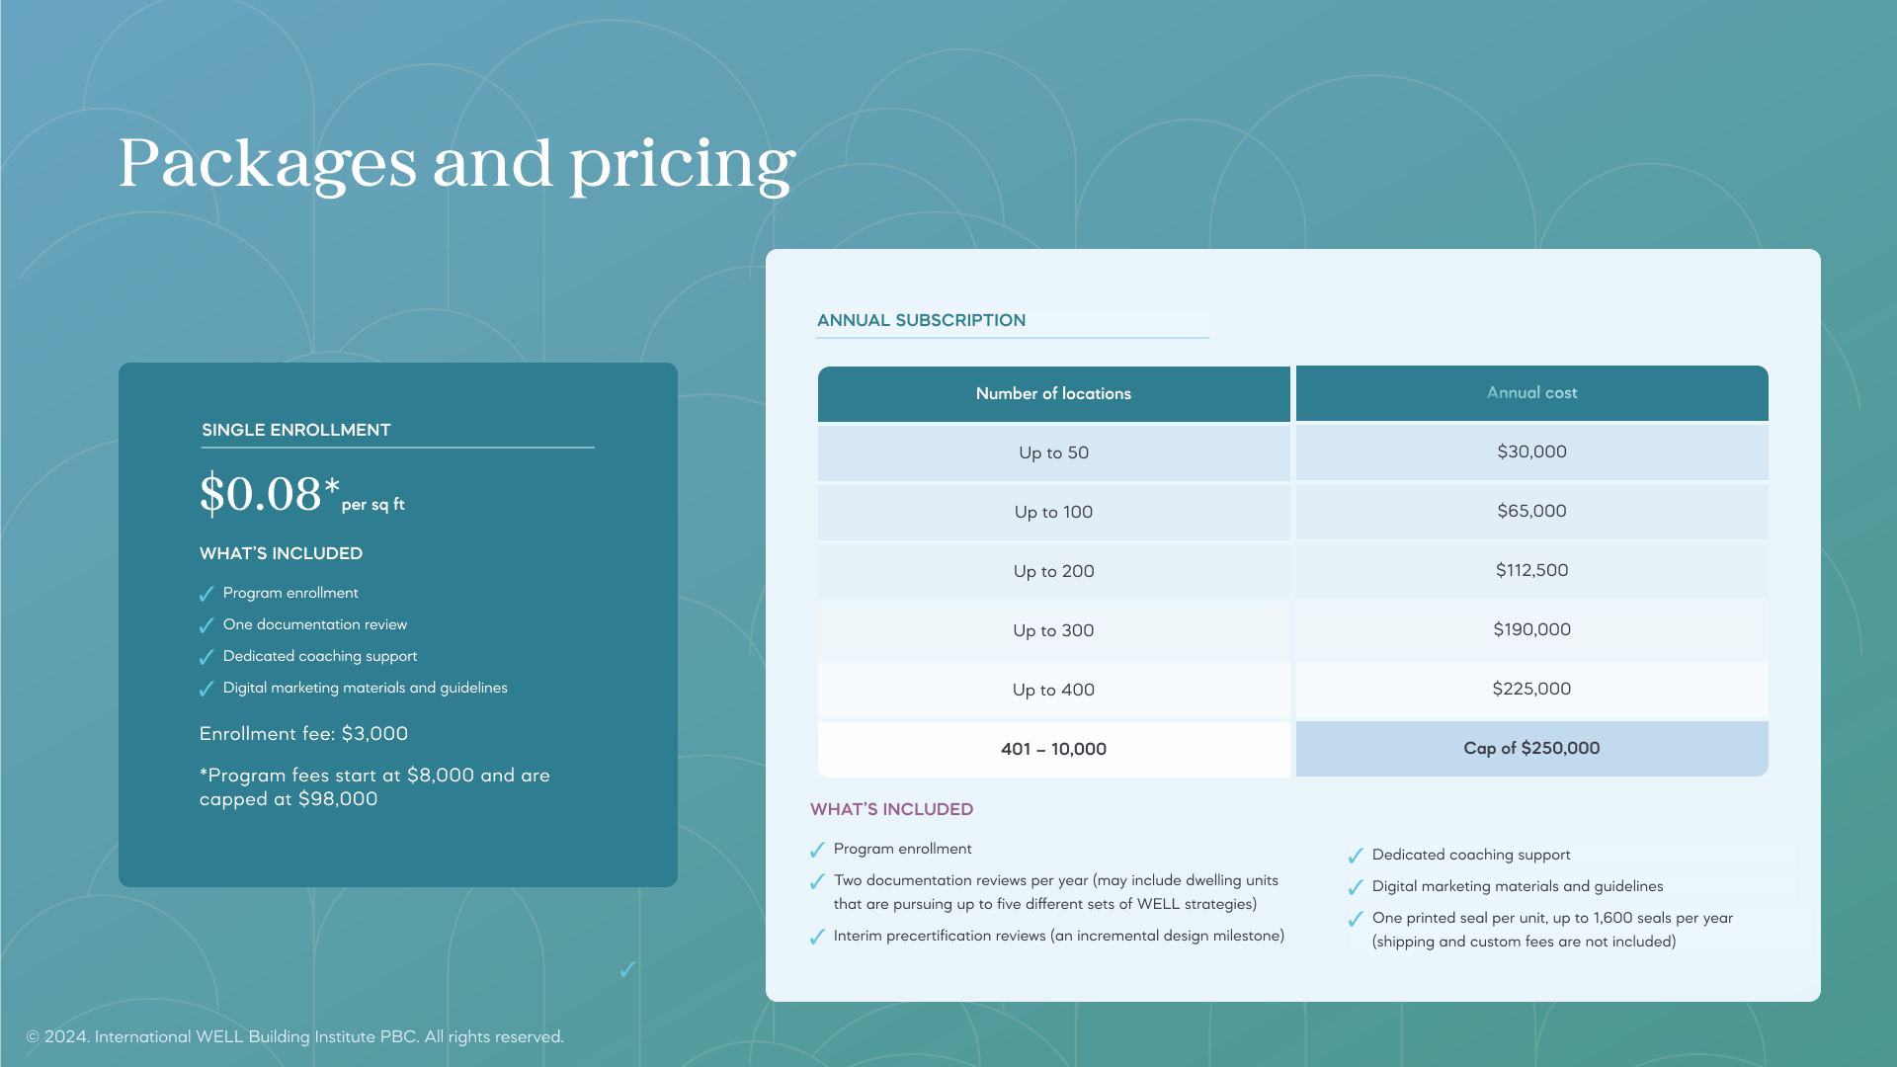

Slide 18
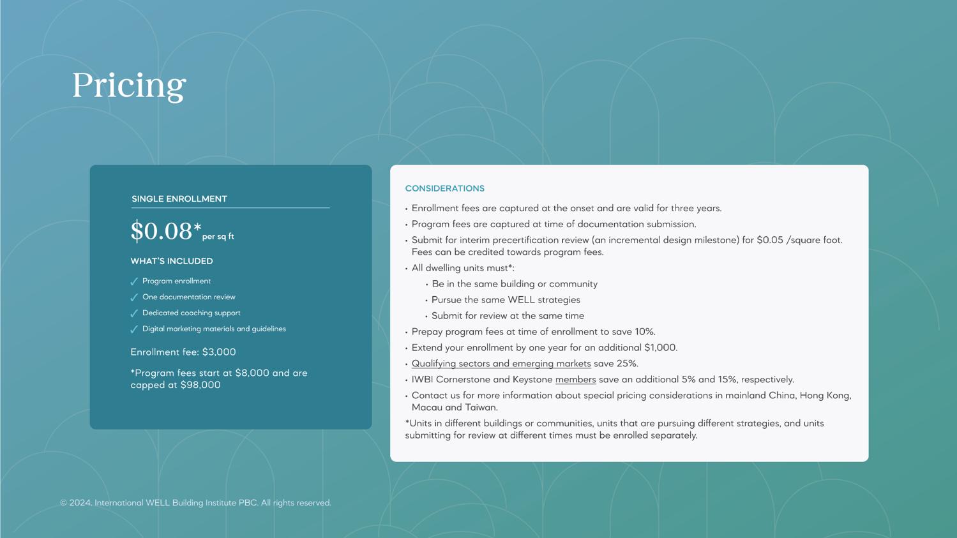

Slide 19
